Slide 1

Banking ROE Competitive Benchmarking Analysis
A detailed 5-year analysis on ROE and ROTE performance, examining competitiveness among Bank ABC, FAB, and GIB.
AI-Generated Presentation • Confidential

Slide 2
Executive Summary
1
2
3
4
5
Key Insight 1
Key Insight 2
Key Insight 3
Key Insight 4
Key Insight 5
The competitive benchmarking analysis compares the Return on Equity (ROE) and Re
FAB leads with a strong and consistent ROTE increase, reaching about 20% by mid-
Bank ABC shows modest ROE improvement but lacks ROTE disclosure, limiting full p
GIB maintains stable but lower ROE and ROTE, with good liquidity and risk manage
External factors such as Basel III regulatory requirements, regional economic gr
2

Slide 3

Key point from this section
1. Introduction
1
Supporting detail
2
Additional insight
3
3

Slide 4

Key point from this section
2. Methodology and Data Overview
1
Supporting detail
2
Additional insight
3
4

Slide 5
3. ROTE and ROE Performance Data Tables
Category 1
Category 2
Category 3
Category 4
Key point from this section
Supporting detail
Additional insight
—
5

Slide 6

Key point from this section
4. Comparative Analysis
1
Supporting detail
2
Additional insight
3
6

Slide 7
5. Bank ABC ROTE/ROE Analysis
STRENGTHS
CHALLENGES
Key point from this section
Supporting detail
7

Slide 8
Key point from this section
6. FAB ROTE/ROE Analysis
1
Supporting detail
2
Additional insight
3
8

Slide 9
Key point from this section
7. GIB ROTE/ROE Analysis
1
Supporting detail
2
Additional insight
3
9

Slide 10

Key point from this section
8. Drivers of ROTE/ROE Differences
1
Supporting detail
2
Additional insight
3
10

Slide 11
Annual ROTE and ROE for Bank ABC and FAB (2021–2025)
BANK
YEAR
ROE (%)
ROTE (%)
Bank ABC
2024
N/A
N/A
First Abu Dhabi Bank
2024
N/A
N/A
Bank ABC
2025 (H1)
N/A
N/A
First Abu Dhabi Bank
2025 (H1)
N/A
20.5
4 records · 4 metrics · Source: Document Analysis
11

Slide 12
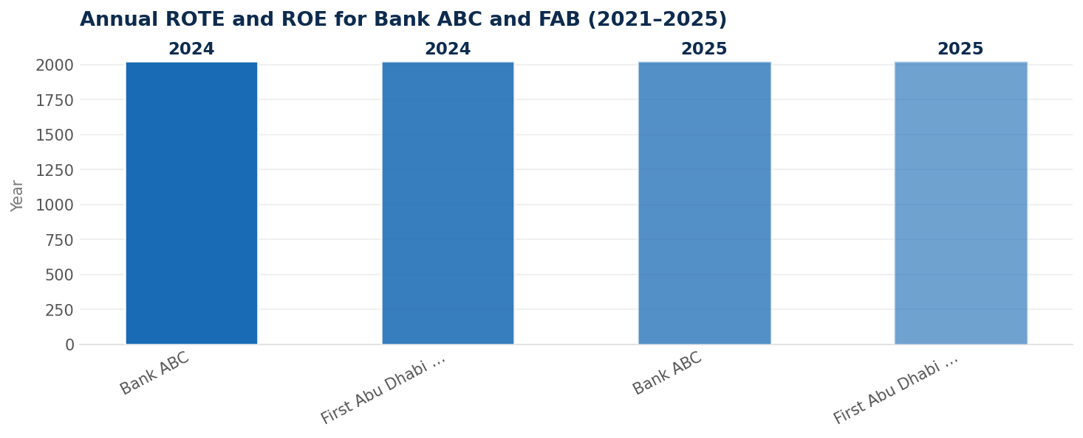
Data Visualization
Data visualization from document analysis
📊
12

Slide 13

Key Takeaways
→
Strategic insight from the analysis
→
Key recommendation
→
Forward looking perspective
13

